Slide 1
.NET Core is the Future of .NET
Excerpts from
Scott Hunter’s May 6, 2019 blog post: https://devblogs.microsoft.com/dotnet/net-core-is-the-future-of-net/
And Richard Lander’s May 6, 2019 blog post: https://devblogs.microsoft.com/dotnet/introducing-net-5/

Slide 2
.NET Core Goal
“Leverage learning experience from delivering .NET Framework for 12 years and build a better product”
Side-by-side installations (no worries about breaking existing apps)
Self-contained applications (deliver or embed .net core vs. machine installs)
Not being a Windows operating system component (frequent releases)
.NET Core open source and cross platform
Source: Scott Hunter - https://devblogs.microsoft.com/dotnet/net-core-is-the-future-of-net/

Slide 3
.NET Core Expansion
.NET Core 1.0
High performance web and microservices
.NET Core 2.0
+ 20K APIs
+ Razor Pages
+ SignalR
.NET Core 3.0
+ Desktop (WinForms, WPF)
+ EF 6
Source: Scott Hunter - https://devblogs.microsoft.com/dotnet/net-core-is-the-future-of-net/

Slide 4
Important Takeaway – Learn .NET Core… NOW
“Summary: New applications should be built on .NET Core. .NET Core is where future investments in .NET will happen. … includes: JIT, AOT, GC, BCL, C#, VB.NET, F#, ASP.NET, Entity Framework, ML.NET, WinForms, WPF and Xamarin.”
“After .NET Core 3.0, we will not port any more features from .NET Framework. .NET Framework 4.8 will be the last major version of the .NET Framework.”
“Existing applications are safe to remain on .NET Framework which will be supported.”
Source: Scott Hunter - https://devblogs.microsoft.com/dotnet/net-core-is-the-future-of-net/

Slide 5
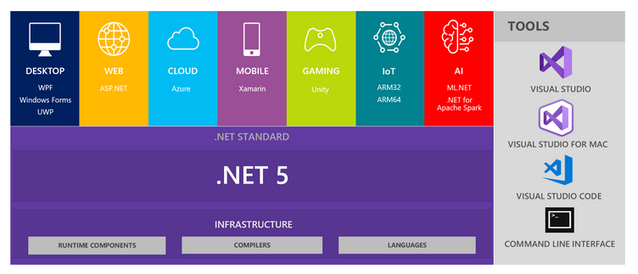
.NET 5: A Unified Platform
Produce a single .NET runtime and framework that can be used everywhere (Windows, Linux macOS, iOS, WebAssembly…)
Consolidate best features from .NET Core, .NET Framework, Xamarin and Mono into .NET 5.
New Apis, runtime capabilities and language features as .NET 5.
Establish single codebase that both Microsoft and community developers can work on and expand together.
Source: Richard Lander: https://devblogs.microsoft.com/dotnet/introducing-net-5/

Slide 6
.NET 5: Design Drivers
Runtime experiences
High throughput & productivity
Fast startup, low footprint an lower memory usage
Fundamentals and overlapping experiences
Source: Richard Lander: https://devblogs.microsoft.com/dotnet/introducing-net-5/

Slide 7
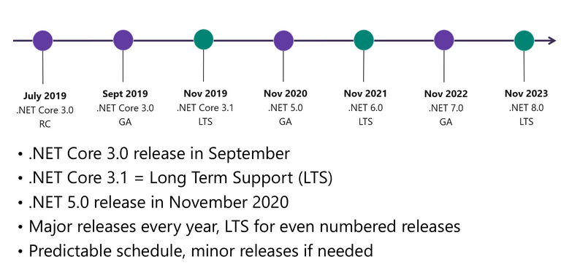
.NET Roadmap
Source: Richard Lander: https://devblogs.microsoft.com/dotnet/introducing-net-5/

